Slide 1
CSCI 3412 Algorithms
P, NP, NP-Completeness, NP-Hard
Chapter 34 NP-Completeness and
Chapter 35 Approximation
Sung Nam

Slide 2
Terminology and Definitions

Slide 3
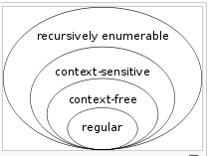
First, Theory of Computation
A fascinating century-long research area
Mathematics + Logics + Computer Science
How efficiently problems can be solved on a model of computation using algorithm.
3 areas of research closely related:
Automata theory – Formal Language Theory (finite state machine (FSM), pushdown machine, …): defining types of problems (See CLSR pp 1057 – 1060)
Computability theory (recursion theory) – Can a problem be computable (solved) in a given unlimited time with limited storage – Turing computability (Halting)
Computational Complexity theory: How efficiently a problem can be solved.

Slide 4
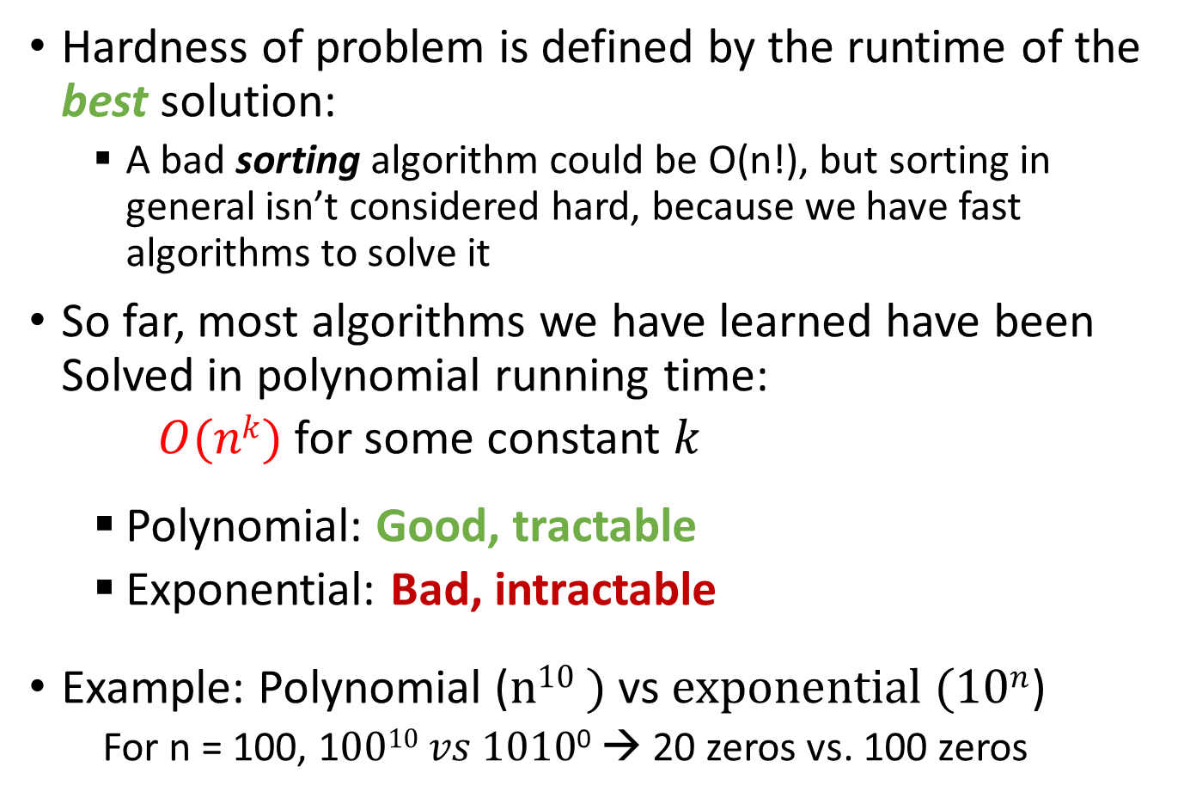
P: Polynomial-time algorithm
Hardness of problem is defined by the runtime of the best solution:
A bad sorting algorithm could be O(n!), but sorting in general isn’t considered hard, because we have fast algorithms to solve it
So far, most algorithms we have learned have been Solved in polynomial running time:
$O(nk)$ for some constant $k$
Polynomial: Good, tractable
Exponential: Bad, intractable
Example: Polynomial ($n10 )$ vs $exponential (10n$)
For n = 100, 1$0010 vs 1010$⁰ → 20 zeros vs. 100 zeros

Slide 5
NP: ????
Nondeterministic Polynomial
NP means Not Polynomial? Non-Polynomial?
!!! NO !!!
NP : Nondeterministic Polynomial time!! That mean it’s a polynomial problem.
What is Nondeterministic?
Originated from Automata Theory
Means you can have many possible solutions to a decision problem but you don’t know how to deterministically find a solution
Always guess a correct answer (certificate)
in other words, a non-deterministic machine returns a correct answer magically for you.
However, what’s possible is that you can verify the correctness of the answer (certificate) in polynomial time. (e.g. sudoku, rubik’s cube, an elephant in the refrigerator, …)

Slide 6
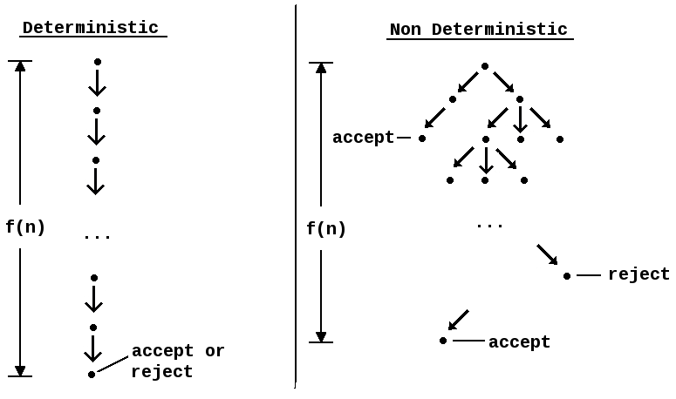
Deterministic vs Non-deterministic
From wikipedia
"branches" into many copies, each of which follows one of the possible transitions. If at least one branch of the tree halts with an "accept" condition, it accepts the input.
a single "computation path" that it follows

Slide 7
P vs. NP P = NP ?

Slide 8
NP Problem Example - Longest simple path -
A simple path in a graph: a path without any repeated edges or vertices.
Need to formalize it as a yes-or-no question (converting to a decision problem): given a graph G, vertices s and t, and a number k, does exist a simple path from s to t with at least k edges?
Why in NP? If magically we are given with a path, we can easily compute and verify its length is less than k.
However, we can’t easily find an algorithm proving that there is no such path existing without actually computing all available paths. (‘Yes’ answer is easy, but ‘No’ answer is hard)
Other NP problems: https://en.wikipedia.org/wiki/List_of_NP-complete_problems

Slide 9
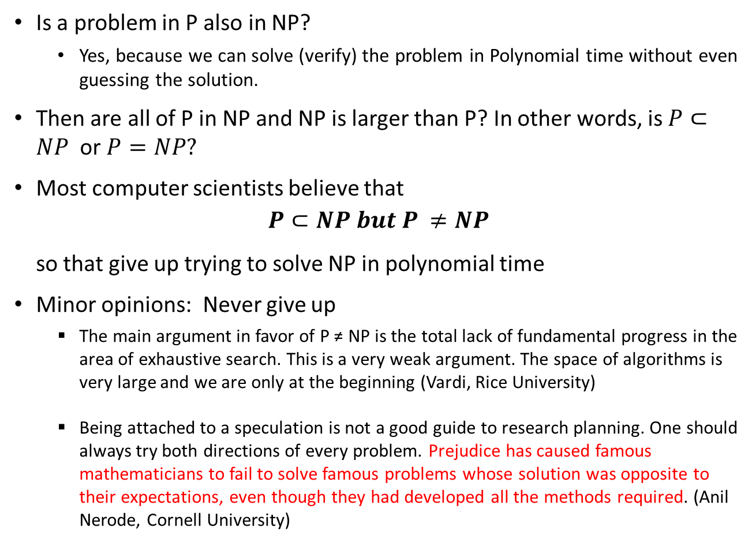
P vs NP
Is a problem in P also in NP?
Yes, because we can solve (verify) the problem in Polynomial time without even guessing the solution.
Then are all of P in NP and NP is larger than P? In other words, is $P⊂NP$ or $P=NP?$
Most computer scientists believe that
$$P⊂NP but P ≠NP$$
so that give up trying to solve NP in polynomial time
Minor opinions: Never give up
The main argument in favor of P ≠ NP is the total lack of fundamental progress in the area of exhaustive search. This is a very weak argument. The space of algorithms is very large and we are only at the beginning (Vardi, Rice University)
Being attached to a speculation is not a good guide to research planning. One should always try both directions of every problem. Prejudice has caused famous mathematicians to fail to solve famous problems whose solution was opposite to their expectations, even though they had developed all the methods required. (Anil Nerode, Cornell University)

Slide 10
What if P = NP?
Source: https://cacm.acm.org/magazines/2009/9/38904-the-status-of-the-p-versus-np-problem/fulltext#body-3
https://en.wikipedia.org/wiki/P_versus_NP_problem#P_=_NP
P = NP means that for every problem that has an efficiently verifiable solution, we can find that solution efficiently as well:
Public-key cryptography becomes impossible. (Broken)
Since all the NP-complete optimization problems become easy, everything will be much more efficient. Transportation of all forms will be scheduled optimally to move people and goods around quicker and cheaper.
Learning becomes easy - near perfect vision recognition, language comprehension and translation and all other learning tasks become trivial.
P = NP would also have big implications in mathematics.
A person who proves P = NP would walk home from the Clay Institute with $1 million check

Slide 11
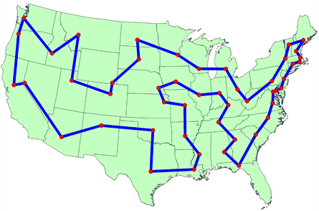
Not NP (Even Harder than NP) problem - Travelling Salesperson Problem -
Problem:
Given a list of cities and the distances between each pair of cities, what is the shortest possible route that visits each city exactly once and returns to the origin city?

Slide 12
Not NP problem example - Travelling Salesperson Problem
Definition of NP: you can verify the correctness of the answer (certificate) in polynomial time.
In TSP, even if you are given with the shortest loop (certificate), you can’t verify it unless you actually solve TSP. In other words, you would not be able to tell there is no other loop shorter than this without solving TSP.
Since it takes exponential time or worse to solve TSP, this solution can not be verified in polynomial time.
So TSP is not an NP problem. It seems much harder.
Then what is it? NP-Hard → harder than NP
Can we convert it to an NP problem?

Slide 13
NP problem example - Converting TSP to an NP problem
In general, for a problem to be an NP problem, it has to be a “decision problem”, which means the problem is to decide if something is true or not.
Converting TSP problem to a decision problem:
Instead of finding the shortest loop going through all cities
Changing the goal → determining if there exists any loop whose total length is less than some fixed number.
For example, the question might be to find a loop that goes through all of these cities with max total distance 100 miles?
This may be as hard as regular TSP because all possible paths should be tested.
But one important difference:
Any solution can be verified in linear time (bound by the number of cities and the distance) → NP problem

Slide 14
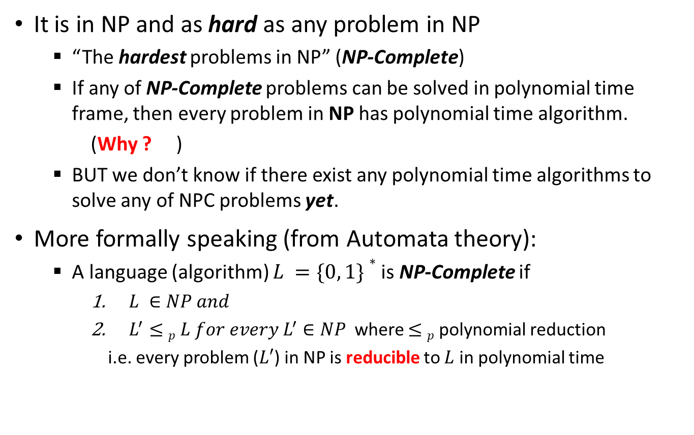
NP-Completeness (NPC, NP-C)
It is in NP and as hard as any problem in NP
“The hardest problems in NP” (NP-Complete)
If any of NP-Complete problems can be solved in polynomial time frame, then every problem in NP has polynomial time algorithm.
(Why ? )
BUT we don’t know if there exist any polynomial time algorithms to solve any of NPC problems yet.
More formally speaking (from Automata theory):
A language (algorithm) $L =\{0, 1\}∗$is NP-Complete if
$L ∈NP and$
$L^{′}≤p L for every L^{′}∈NP$ where $≤p$polynomial reduction
i.e. every problem ($L′$) in NP is reducible to $L$ in polynomial time

Slide 15
NP-Hard
A language L satisfies property 2 from previous slide, but not necessarily property 1.
We say that L is NP-Hard.
This means that NP-Hard problem is harder than or equal to NP but it may not belong to NP. (Harder)
Basically, there is no solution and no verification of a given answer in polynomial time.
Examples:
Travelling Salesperson (TSP) problem
Subset sum problems
Halting problem
Hamilton Cycle problem

Slide 16
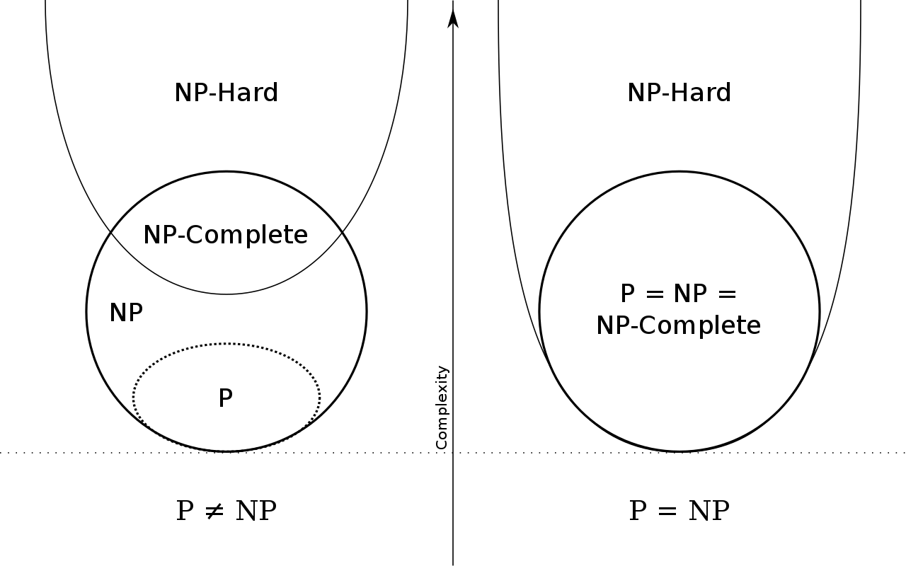
Putting together
NP-completeness is at the crux of deciding whether P is, in fact, equal to NP.

Slide 17
NP Complete (NPC)

Slide 18
Overview of NP-Complete Problem
Identifying NP-Complete – by showing how hard a problem is, rather than how easy it is.
A problem A in NP is NP-complete when, for every other problem B in NP, B is reduced to A
Informally speaking, NP-C is the hardest NP problem.
Confined to the decision problems but can be used for the analysis of complexity of optimization problem as well by associating a bound on the value to be optimized.
i.e. Can we find the shortest path between the source and the destination within 350 miles?

Slide 19
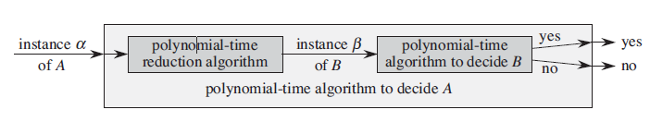
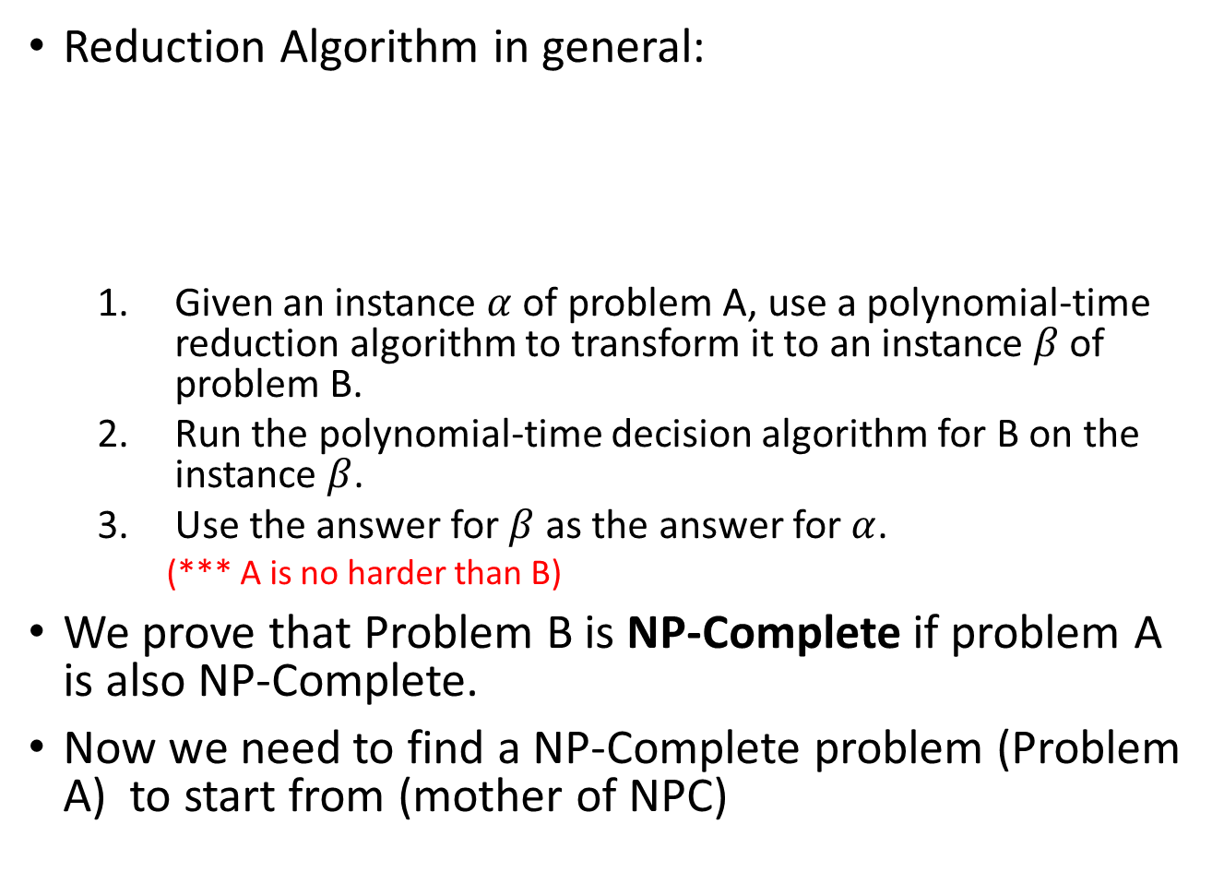
Identifying NP-Completeness: Reduction
Reduction Algorithm in general:
Given an instance $α$ of problem A, use a polynomial-time reduction algorithm to transform it to an instance $β$of problem B.
Run the polynomial-time decision algorithm for B on the instance $β$.
Use the answer for $β$ as the answer for $α$.
(*** A is no harder than B)
We prove that Problem B is NP-Complete if problem A is also NP-Complete.
Now we need to find a NP-Complete problem (Problem A) to start from (mother of NPC)

Slide 20
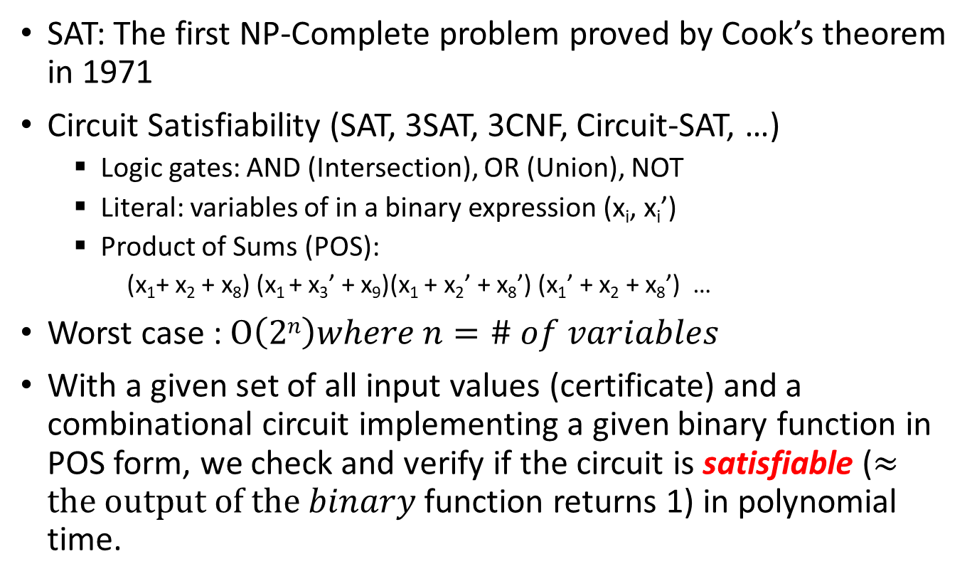
Grandfather of NP-Complete
SAT: The first NP-Complete problem proved by Cook’s theorem in 1971
Circuit Satisfiability (SAT, 3SAT, 3CNF, Circuit-SAT, …)
Logic gates: AND (Intersection), OR (Union), NOT
Literal: variables of in a binary expression (x_{i}, x_{i}’)
Product of Sums (POS):
(x₁+ x₂ + x₈) (x₁ + x₃’ + x₉)(x₁ + x₂’ + x₈’) (x₁’ + x₂ + x₈’) …
Worst case : $O\left(2n\right)where n=\# of variables$
With a given set of all input values (certificate) and a combinational circuit implementing a given binary function in POS form, we check and verify if the circuit is satisfiable ($≈the output of the binary$ function returns 1) in polynomial time.
x₀ | x₁ | x₂
0 | 0 | 0
0 | 0 | 1
0 | 1 | 0
0 | 1 | 1
1 | 0 | 0
1 | 0 | 1
1 | 1 | 0
1 | 1 | 1

Slide 21
NP-Complete Reduction Example
It would be difficult to prove anything else like 3 SAT.
Instead, they are based on the observation that if A is reduced to B and B to C, then A is reduced to C.
As a consequence of this observation, if A is NP-complete, B is in NP, and A is reduced to B, B is NP-complete.
We start with one specific problem that we prove NP-complete, and we then prove that it's easier than lots of others which must therefore also be NP-complete.
For example, since Hamiltonian cycle is known to be NP-complete, and Hamiltonian cycle is reduced to longest path, we can deduce that longest path is also NP-complete.

Slide 22
Why bother to learn this stuff?
There is relatively easy way to establish that a problem in your hand is a NP-Complete problem.
Many of NPC problems have practical significance
So what? Remember the benefits of knowing the lower bound of comparison-based sorting algorithm?
For such hard NPC problems, instead of being hung up to solve the problem, we may find ways to get around
Heuristic - come up with a method for solving a reasonable fraction of the common cases.
Solve the problem approximately instead of exactly.
Choose a better abstraction. Redefine the problem with different set of constraints.
Use an exponential time solution anyway. If you really have to solve the problem exactly, settle down with the exponential solution and stop worrying about finding a better solution.
These returns near-optimal solution, approximation algorithm
Sometimes, the best is the enemy of betterment !!!

Slide 23
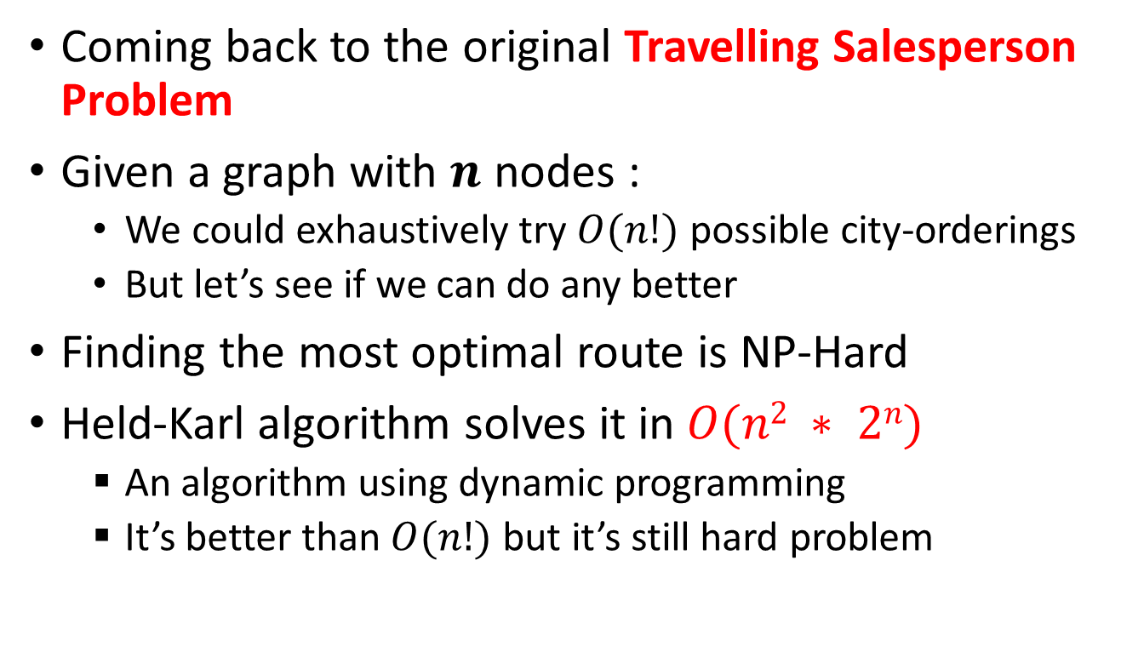
TSP Hardness
Coming back to the original Travelling Salesperson Problem
Given a graph with $n$ nodes :
We could exhaustively try $O(n!)$ possible city-orderings
But let’s see if we can do any better
Finding the most optimal route is NP-Hard
Held-Karl algorithm solves it in $O(n2 ∗ 2n)$
An algorithm using dynamic programming
It’s better than $O(n!)$ but it’s still hard problem

Slide 24
TSP: Can we do differently?
Sometimes the best approach is to accept that getting the absolute best solution is impossible
but we can get reasonably close by solving simpler versions of the problem that we do know how to solve
Relaxing constraints …
In this case, what if we were
allowed to visit a city more than once, and
allowed to retrace your steps for free?
How about reducing the problem to connecting all the cities as cheaply as possible
- do we know how to solve this problem?

Slide 25
MST as a starting point to approximate TSP
MST is an easy problem to solve
Provides a lower bound for the real solution
Claim: An MST with free backtracking would be better than a TSP following all the original rules (Why ?)
MST is the best spanning tree by definition
Backtracking is free
If we find a solution to the original problem later, we can use the MST as a comparison for how close we might be.
Why?
If an MST for some graph has total 100 miles distance, but a given solution has total distance of 110, we are at most 10% longer than the best possible solution

Slide 26
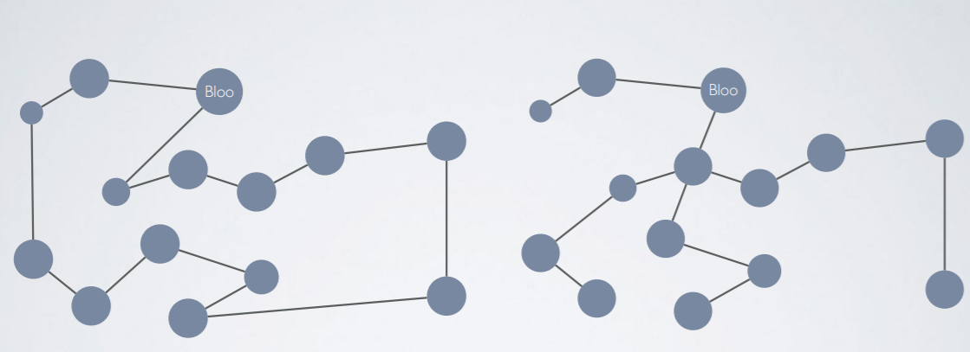
Best route (visit) vs. MST (connected)
1
1
2
2
3
Best route
MST

Slide 27

Not NP (Even Harder than NP) problem - Travelling Salesperson Problem -
Problem:
Given a list of cities and the distances between each pair of cities, what is the shortest possible route that visits each city exactly once and returns to the origin city?

